Slide 1
present continuous

Slide 2

Now
Am
I
Jumpingreading
sleeping
?
he
she
it
Is
you
we
they
Are

Slide 3
Now
Yes,
I
am.
No,
‘m not.
I
he
she
it
he
she
it
Yes,
is.
No,
isn’t.
you
we
they
you
we
they
Yes,
are.
No,
aren’t.

Slide 4
Look and make the questions

Slide 5
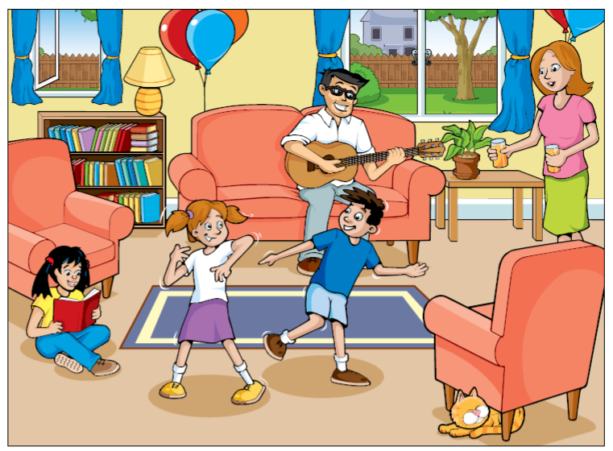

Slide 6
keys
Are they(girls) dancing?
Yes, they are.
Is she(girl) writing?
No, she isn’t.
Is she(mom) giving the juice?
Yes, she is.
Is he(dad) playing the piano?
No, he isn’t.
Is cat sleeping under the chair?
Yes, it is.

